Slide 1
AWS SAM
Author: Dung.Nguyen@furucm.com

Slide 2
What is SAM?
SAM is the abbreviation of Serverless Application Model. It’s an open framework to build serverless applications.
Serverless applications are event-driven cloud-based systems where application development rely solely on a combination of third-party services, client-side logic and cloud-hosted remote procedure calls (Functions as a Service).
Ex : AWS Lambda, Microsoft Azure Functions, Google Cloud Functions and IBM OpenWhisk

Slide 3
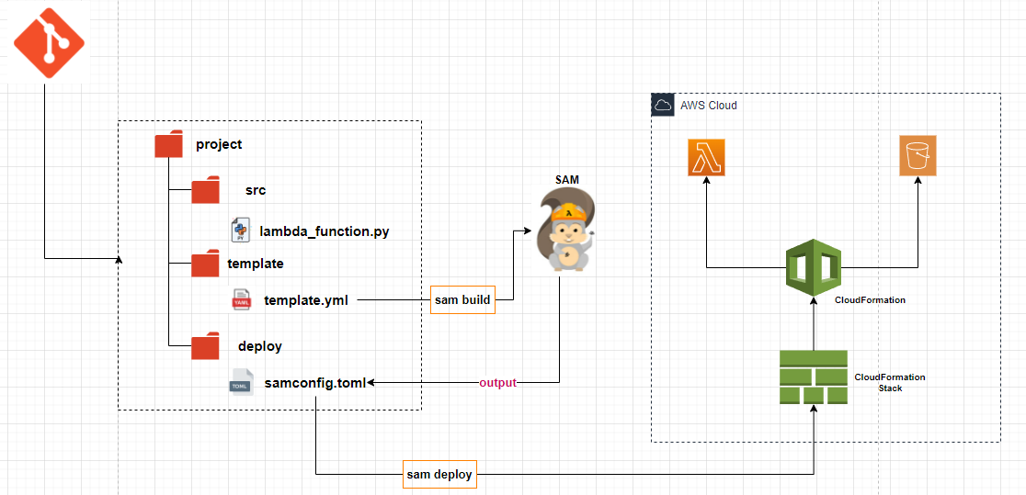
SAM workflow

Slide 4
CloudFormation
An infrastructure as code (IaC) service that allows you to easily model, provision, and manage AWS and third-party resources.
CloudFormation uses stack as a collection of AWS resources that you can manage as a single unit. In other words, you can create, update, or delete a collection of resources by creating, updating, or deleting stacks. It simulates commits of GIT.
When a stack is created/updated, AWS CloudFormation should generate a new infrastructure on AWS and vice versa when it is deleted.

Slide 5
Demo prerequisite
Install python (lambda supports to python 3.9)
Install Sam cli (at step 4)
Install Aws cli
Install docker decktop
Install awslocal : pip install awscli-local

Slide 6
Demo
Hello Sam

Slide 7
Demo
SAM with S3 in work

Slide 8
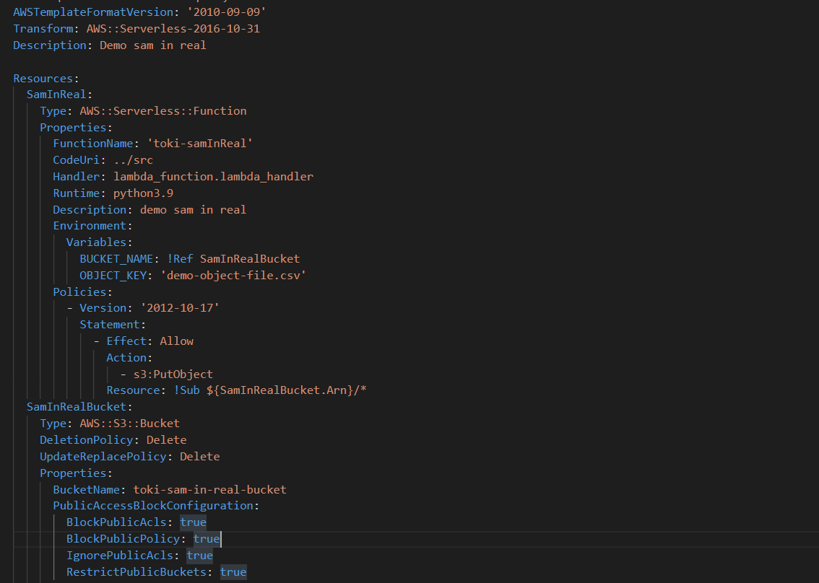
Cloudformation yaml
Structure of CloudFormation yml
Intrinsic function reference
AWS S3 Api document
Boto3 document

Slide 9
GIT
Source git

Slide 10

Thank for your time

